Slide 1



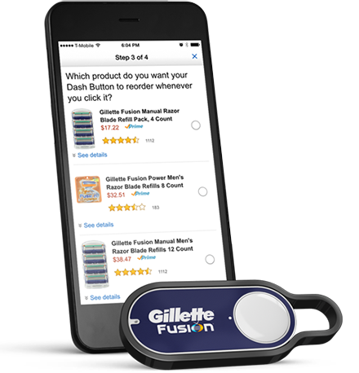
Amazon Dash is Not an April Fools Joke
UC Berkeley EECS Head TA Michael Ball
The Beauty and Joy of Computing Lecture #18
Besides Blocks I:
Intro to Python
Amazon Dash is a new device which automatically orders a specific whenever you push it’s button. Amazon created “1-click” ordering in the 1990’s, but do you can do it without a computer. The button is a test device for a program which will allow other devices to order items, like replacement ink or coffee.
https://www.amazon.com/oc/dash-button

Slide 2
Admin Notes
Reminder: Explore Project Part 2 is due Friday
Comments
Artifact + Explanation
Final Projects start next week!
Use Snap! or Python
Individual
3-weeks to work
Demo: (review)) Exporting files from Snap!

Slide 3
Why Learn Python?

Slide 4
The Goals of BJC
BJC’s goal is not to teach you Snap!
Teach you critical thinking about societal implications of computing
Teach you how to program (Snap! is the best intro language we know) and help you succeed in the future
More importantly: Teach you how to think like a computer scientist in life, called “computational thinking”

Slide 5
What is Computational Thinking?
Using abstraction (removing detail and generalization with parameters)
It’s understanding the value of a “spec” that specifies a contract
The iterative design cycle: design, prototype, implement, evaluate (loop)
Thinking about how solutions scale, parallelize, generalize, and trying to foresee the unintended consequences!

Slide 6
Why Learn Python?
You already know it!
Syntax is very similar to Snap!, especially like writing Snap! on paper.
Python (also) runs everywhere
OS X and Windows, and now there are browser apps (Cloud9.io) and even iOS apps
Lots of online support
Plenty of advanced libraries
Everything from graphics processing to AI to games!
Used in industry and academia

Slide 7
What You’ll Learn
New Syntax
Different way to write programs you already know how to write (in Snap!)
A little bit about the command line
A text-based interface that exposes you to the internals of how a computer works
How to find help online
A little more about Object Oriented Programming
Programming is really not about the language or environment

Slide 8
Demo

Slide 9
Intro To Python

Slide 10
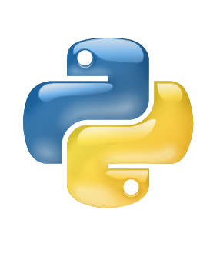
Getting Python 3
We’ll be using Python 3 for this class.
It does have some minor changes from Python 2, but you don’t need to worry about what they are.
Download Python 3 from
https://python.org/downloads
Run the graphical installer
All official Python documentation is at
https://docs.python.org

Slide 11
Intro to the Command Line
“Terminal” on OS X (and Linux) and “Command Prompt” on Windows
a.k.a. “Unix shell” on Mac and Linux
Does the same things as the rest of your computer (browse and edit files, even browse the web!)
OS X:
Open: /Applications/Utilities/Terminal.app
Windows:
Use the search bar for “cmd”

Slide 12
Python Programs
Python programs are just a text file with Python syntax.
To run a program you type:
python file_name.py
(Sometimes this is python3 )
Aside: a moonscape font indicates a command to run.
Python has two modes – “normal” and “interactive”
Interactive mode happens if you don’t provide a file to run.
After each command Python evaluates your code and returns the response. (Kind of like clicking a block in Snap!)
Use python -i file_name.py
Force a file to be run in interactive mode.

Slide 13
Snap! ←→ Python

Slide 14


Text and Numbers
Numbers in Python are called
ints (numbers w/o decimals)
floats (numbers with decimals)
Strings:
Some text in between quotes “” or ‘’
>>> 2 + 2
4
>>> "Hello, " + "world"
'Hello, world'

Slide 15
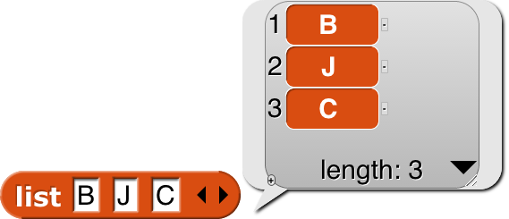

Lists
Lists Work in much the same way:
Syntax: [itemA, itemB, itemC]
>>> ['B', 'J', 'C']
['B', 'J', 'C']
>>> len(['B', 'J', 'C'])
3

Slide 16


BEWARE: Item 0!
However, there is one big difference!
The first item in Python is item 0.
This also applies for strings as well.
Access items using [#]
>>> letters = ['B', 'J', 'C']
>>> letters[0]
'B'
>>> 'Hello, World!'[7]
'W'

Slide 17
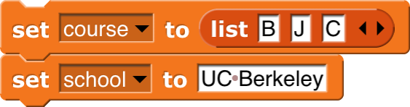

Variables
No need to “declare” variable in Python,
Just use =
To access a variable, type it’s name
>>> course = ['B', 'J', 'C']
>>> school = ’UC Berkeley’
>>> course
['B', 'J', 'C']
>>> school
’UC Berkeley'

Slide 18
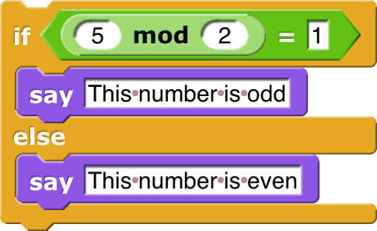
Conditionals
>>> if (5 % 2) == 1:
... print('This number is odd')
... else:
... print('This number is even')
...
This number is odd

Slide 19
Conditionals
Conditionals Work the same way.
End the condition with :
Parentheses are optional around the condition.
Indent the body 1 “level” (usually 4 spaces
Indentation matters in Python!
To end a condition, just un-indent your code
You can also see that mod in Python is a %
Note that the equals check is ==
Python also supports an if (without the else) just like Snap!

Slide 20
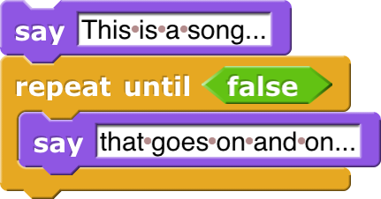
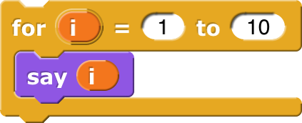
Loops
>>> print('this is a song...')
this is a song...
>>> while(True):
... print('that goes on and on...')
...
that goes on and on...
[omitted]
>>> for i in range(1, 11):
... print(i)
...
1 [omitted 2…10[

Slide 21
Loops
Loops are similar to conditionals.
Instead of an “until” loop, Python has a “while” loop.
Python is missing the repeat(n) loop and the forever loop, but you can make these with whole and for loops.
Note: range() is a function which is includes the first item, but not the last!
range(1,10) counts from 1 to 9!
You can use this function anywhere in Python.

Slide 22
Functions
>>> def factorial(n):
... if n < 1:
... return 1
... else:
... return n * factorial(n - 1)
...
>>> factorial(4)
24

Slide 23
Functions
There is no distinction between a command, reporter or predicate.
You can simply use: return None or just return
Python uses the word def
The body of function is indented
All arguments are specified in () and must come at the end of the function name
report → return
Recursion works exactly the same as in Snap!
Call a function like this: name(arg1, arg2..)

Slide 24
Summary
Lots of little syntax differences!
The Python documentation is your friend
Don’t get too hung up on the differences and don’t get discouraged when you get an error!
There’s so much more to Python in the coming weeks:
Python has thousands of additional, useful built in tools
Python supports HOFs and lambdas
Lots of cool libraries to explore (including turtle graphics)

